Slide 1
Job Evaluation and Analysis
Sample Output

Slide 2
Legends on the detailed relativity charts** and analysis [2/2]
Category | Description
Negative Outlier | Current Grade of Role > Proposed Band for the Role (i.e. currently over-graded)
Positive Outlier | Current Grade of Role < Proposed Band for the Role (i.e. currently under-graded)
High Step Gap | Subordinate’s JE score < 35% of supervisor’s JE score
Low Step Gap | Subordinate’s JE score >70% of supervisor’s JE score
High Step Gap
Low Step Gap

Slide 3


Emerging Relativity of roles – SBUs (BU-A)
Negative Outlier
High Step-Gap
High Span of Control
Positive Outlier
Low Step-Gap
Low Span of Control
L1
L2
L3
L4
L5
L6
L7
L8
1350-2000
SBU Head – BU-A (CX1) 1418
50%
High Step Gap (Almost): Manager will end up spending effort in working with this role / guiding / directing sales effort
Subordinate role is unlikely to be a potential successor to the manager’s role
950-1349
42%
686-949
Unit Head - Large (L1B) 904
40%
502-685
Head-Business Development (BI) (L2B/M1) 579
Head- Sales and Marketing (BUA) (L2A/L2B) 666
Head-Operations, (L2B) 666
40%
Site Lead - Finance & accounts = (M1/M2) 551
369-501
Plant Manager (M3) 449
Head-Engineering (M1/M2) 496
Site Lead-HR & Admin. (Unit HR Head) (M1) 496
Site Lead-Quality (M1/M2) 479
Site Lead-Materials, BUA (M1) 383
Site Lead-Safety & Health (M1) 393
35%
310-368
Section Incharge - Production (M3/M4/M5) 353
Lead-Instrumentation (M2/M3) 344
Lead-Civil (M4) 344
Lead-Mechanical (M2/M3) 344
Lead-Utilities (M2/M3) 344
Lead-MIQA (M2/M3) 333
Lead-Industrial Relations & Compliance Mgmt. (M4) 323
Site Lead-Commercial (M2/M3) 344
Lead-Stores (M2/M3) 344
Site Lead-Environment (M2/M3) 333
20%
Executive Assistant (to SBU Head) (M1) 353
268-309
Site Lead - Admin. & Security (M02) 291
15%
267 and Below
Current incumbent placed at a higher grade than evaluated
Shift Incharge - Production (M4/M5/M6/M7) 261

Slide 4
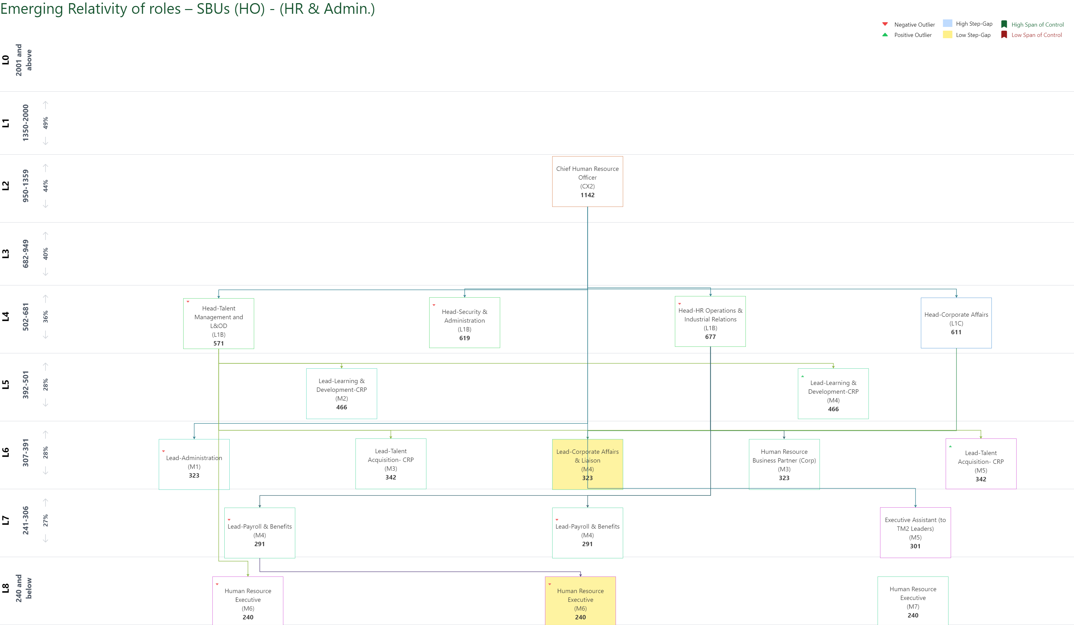

Slide 5
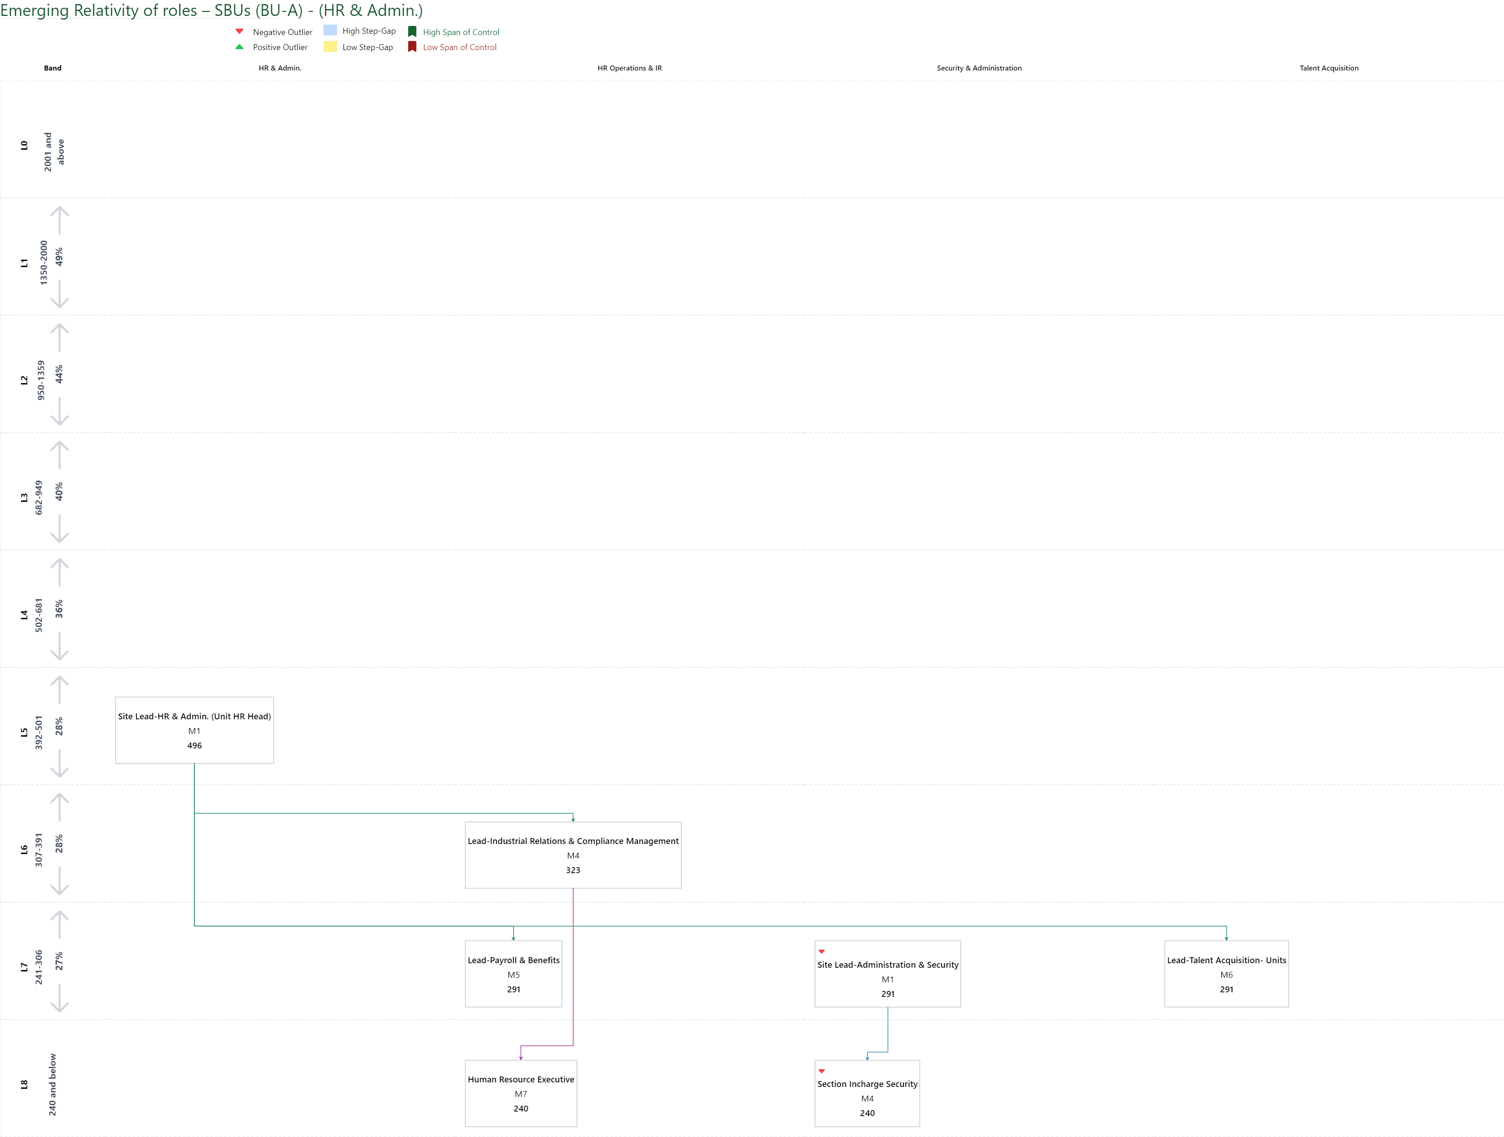

Slide 6
Emerging Relativity of roles – SCM
Negative Outlier
High Step-Gap
High Span of Control
Positive Outlier
Low Step-Gap
Low Span of Control
L1
L2
L3
L4
L5
L6
L7
L8
1350-2000
50%
950-1349
Head - Supply Chain (New role ) 1252
42%
686-949
Head-Strategic Sourcing (Raw Materials)/ Head-Materials (L1A) 732
40%
502-685
Head-Commercial (L1C) 611
40%
40%
369-501
Lead-Materials / Lead-Sourcing (Raw Materials) (M3/M4) 438
35%
310-368
Lead- Logistics (M4) 344
Lead-Commercial (M2/M3) 344
20%
268-309
15%
267 and Below

Slide 7
End of the Document

